Slide 1
Marmara Üniversitesi Management Information Systems and Engineering E-Marketing / Content Marketing
Meriç Genç

Slide 2
What is Content Marketing ?
Content marketing is a strategic marketing approach focused on creating and distributing valuable, relevant, and consistent content to attract and retain a clearly-defined audience — and, ultimately, to drive profitable customer action.
Content marketing is a marketing program that centers on creating, publishing, and distributing content for your target audience -- usually online -- the goal of which is to attract new customers.

Slide 3
What is Content Marketing ?
A content published within the frames of a marketing activity, does not have to be only about the brand itself or towards direct sales.
The main goal of the content is to catch the attention of the user by interesting, creative, fun or useful content or according to users needs or solving their problem.
“People don't read ads. They read what interests them, and sometimes it is an ad.”
Howard Gossage
Notes:
karşılamak, problemlerini çözmektir.

Slide 4
What are the questions while doing Content Marketing ?
What kind of communication language will be used ? Which needs to be resolved ?
In which channels should be actively involved ? (Social Media, E-Mailing, Web Site etc.)
Which content types should be used ? (Visual, Auditory, Text)
Who are the persons that consistently creates quality content for the brand ?
Who will manage the follower committee ? Who and how can they communicate for the brand ?
How can create attractive and efficient content ?
How can be seen more in search engines ?
How can trigger the social sharing and viral spread ? (Headers, Visuals, Selecting a Topic etc.)
Which metrics should be used to analize the feedback of investment on content?
How can we provide the reader encounter the brand content again (thus making another probable sales) ?

Slide 5
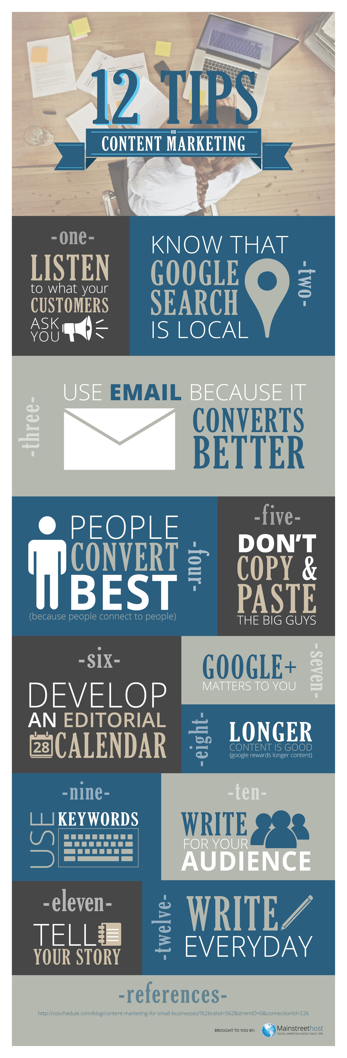

Slide 6
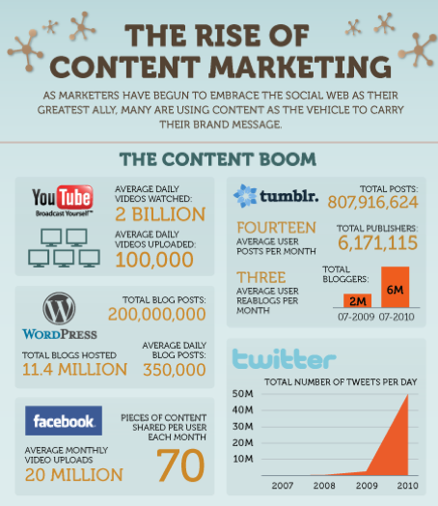

Slide 7
Why Content Marketing ?
Perhaps more important than understand what content marketing is, is understanding why content marketing is important to your business. First we need to understand the four steps of the buying cycle:
Awareness. Prior to awareness a customer may have a need, but they are not aware there is a solution.
Research. Once a customer is aware there is a solution, they will perform research to educate themselves. For example, a car buyer will try to find out what different types of cars exist, and which one will fit their needs.
Consideration. At this point the customer starts comparing different products from different vendors to make sure they’re getting a high quality product at a fair price.
Buy. Finally, the customer makes their decision and moves forward with the transaction.
Traditional advertising and marketing is great when it comes to the second two steps. Content marketing taps into the first two stages of the buying process by raising awareness of solutions and educating consumers about a product they may have never considered before.

Slide 8
Implications
The rise of content marketing has turned traditional businesses into media publishing companies.
For example:
Red Bull, which sells a high-energy beverage, has published YouTube videos, hosted experiences, and sponsored events around extreme sports and activities like mountain biking, BMX, motocross, snowboarding, skateboarding, cliff-diving, freestyle motocross, and Formula 1 racing. Red Bull Media House is a unit of Red Bull that "produces full-length feature films for cinema and downstream channels (DVD, VOD, TV).“ The Red Bulletin is an international monthly magazine Red Bull publishes with a focus on men's sports, culture, and lifestyle.

Slide 9
Implications
The rise of content marketing has also accelerated the growth of online platforms, such as YouTube, Yelp, LinkedIn, Tumblr, Pinterest, and more.
For example:
YouTube, a subsidiary of Google, is an online video platform driving (and benefiting from) the surge to content marketing. As of 2016, YouTube had over 1 billion users, representing 1/3 of all internet users and reaching more 18-34 yrs olds than any cable provider in the U.S.

Slide 10

OUESTIONS ?

Slide 11
THANKS !

Slide 12
References
http://www.mainstreethost.com/blog/12-content-marketing-tips-small-business/
http://blog.turkcell.com.tr/icerik-pazarlamasi-nedir
http://www.forbes.com/sites/joshsteimle/2014/09/19/what-is-content-marketing/#3e847cf11d70
https://en.wikipedia.org/wiki/Content_marketing

